Slide 1
Election Night Predictions and Analysis Data Science Honors Program

Slide 2
Potential graphics to be used for Election Night live broadcast
In this presentation, we showcase a range of dynamic graphics designed for use in the live Election Night broadcast on November 5, 2024. These visuals aim to enhance viewer engagement by providing insightful predictions and real-time analysis as election results unfold.

Slide 3
Trends in early in-person voting
We want to compare the rates of early voting in this year's election to those of previous years.
This will be important as the results of early voting will be the only results we have early in the broadcast. It is important then for us to have a relevant frame of reference to compare them to.

Slide 4
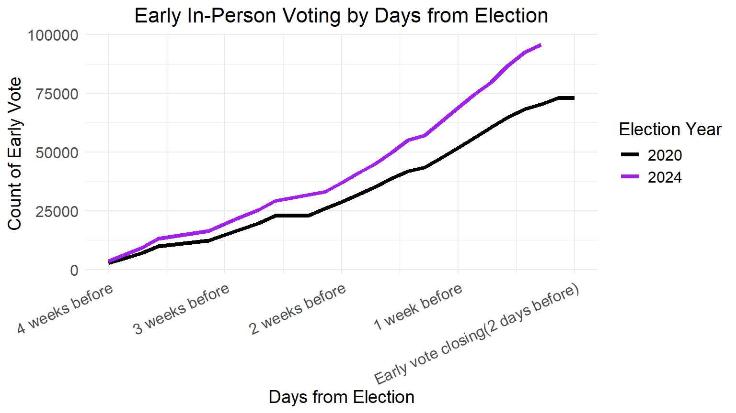
Key Points:
The purple line (2024) shows a higher count of early in-person voting compared to the black line (2020), particularly as the election date approaches.
Early voting in 2024 consistently outpaces 2020, indicating increased early voter turnout or engagement.

Slide 5
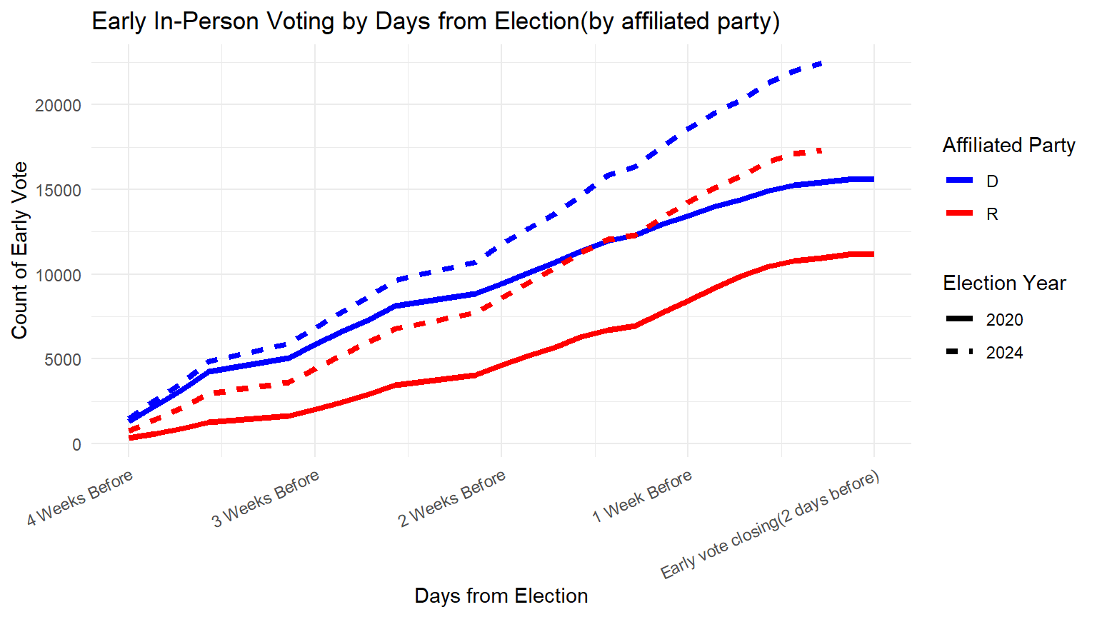
Key Points:
Democratic (blue) and Republican (red) early in-person voting trends are shown for both 2020 (solid lines) and 2024 (dashed lines).
Republican early voting also increases in 2024, but the rise is less pronounced compared to the Democratic increase.
Democratic early voting in 2024 is noticeably higher than in 2020, especially in the final days before early voting closes.

Slide 6
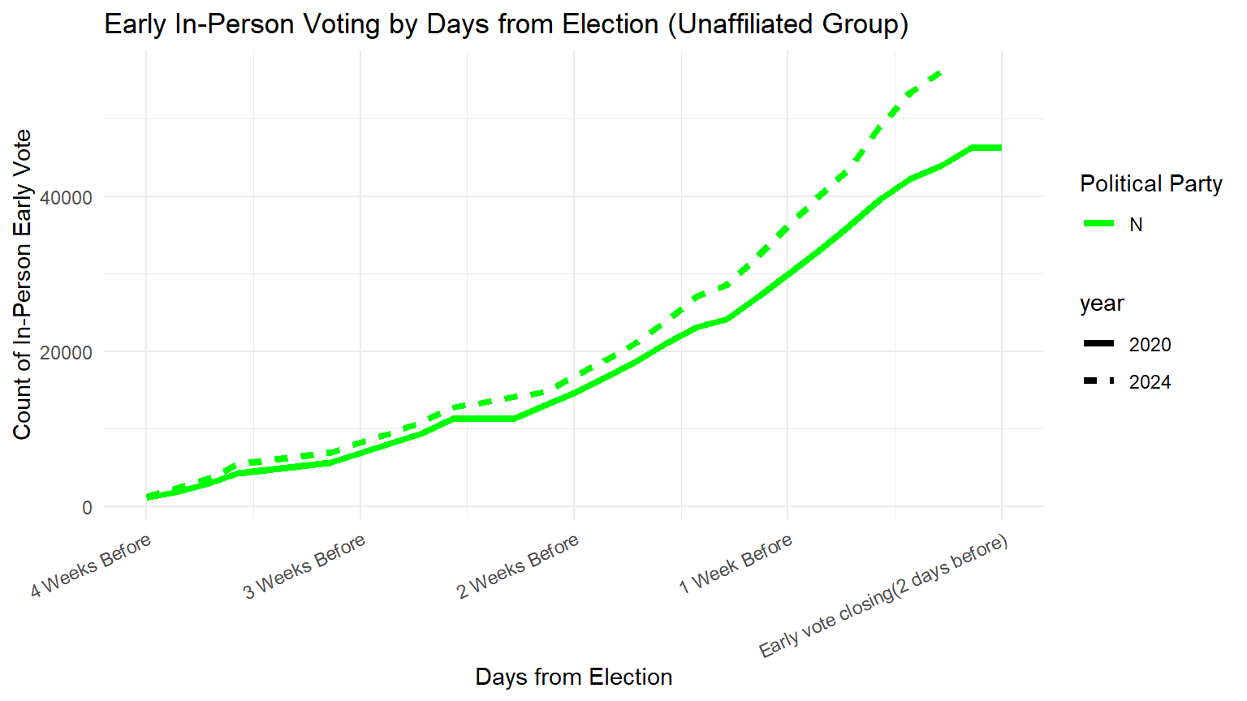
Key Points:
Unaffiliated voters (green lines) also show a significant increase in early voting in 2024 (dashed line) compared to 2020 (solid line).
The upward trend for unaffiliated voters suggests a broader increase in early voting interest, crossing party affiliations.

Slide 7
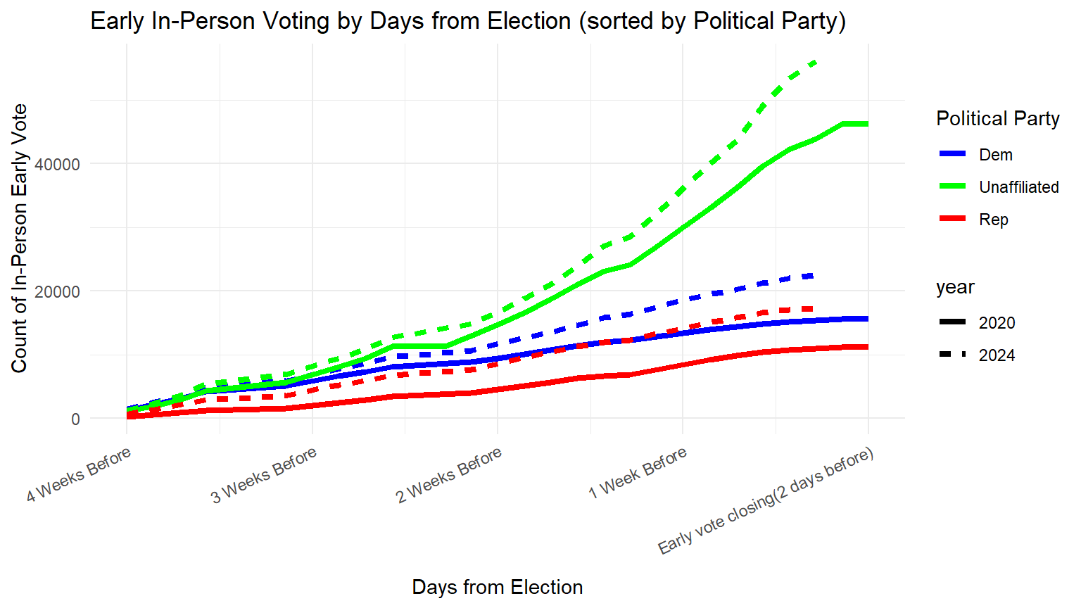
Early in-person 2020
D 15,603 (21.4%)
R 11,161 (15.3%)
U 46,256 (63.3%)
Total: 73,020
Early in-person 2024
D 22,454 (23.4%)
R 17,310 (18.1%)
U 56,057 (58.5%)
Total: 95,821

Slide 8
Early in-person voting - Geography
Our motivation was to investigate if the pattern of early in-person voting is affected by the distance one needs to travel to get to the Hamilton County Board of Elections office to early vote.
Includes:
Maps of the rates of early in-person voting by precinct
Visualization of early in-person voting rates as in relation to distance from BOE

Slide 9
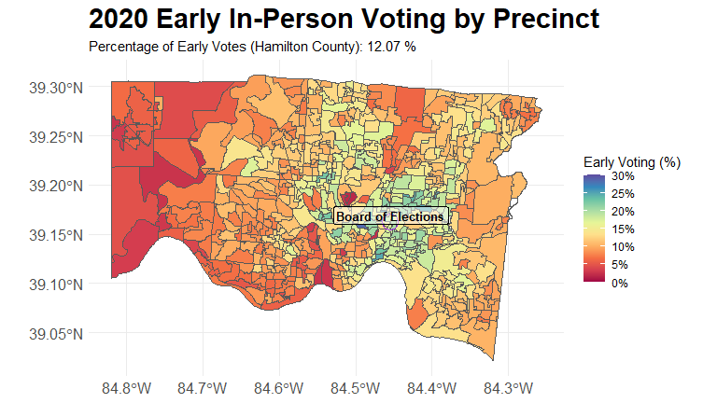

Slide 10
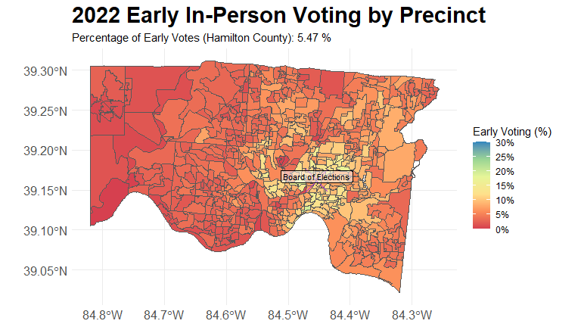

Slide 11
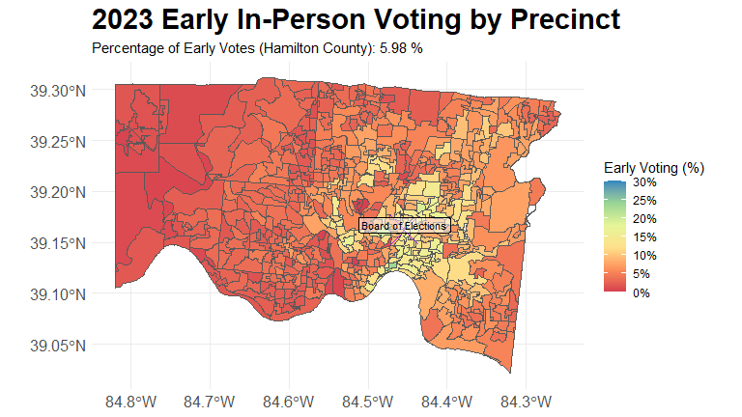

Slide 12
Key Take-aways
Early in-person voting was highest in 2020 due to COVID and a Presidential Election Year.
We can also see that a large population of people who Voted Early is located close to the Board of Elections Office. (This is further demonstrated in the following.)

Slide 13
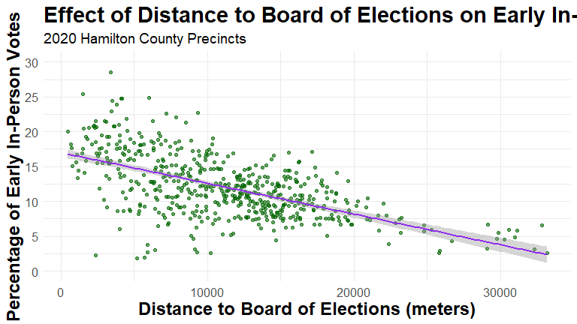
The trend shows that voters living closer to the Board of Elections are more likely to vote early.

Slide 14
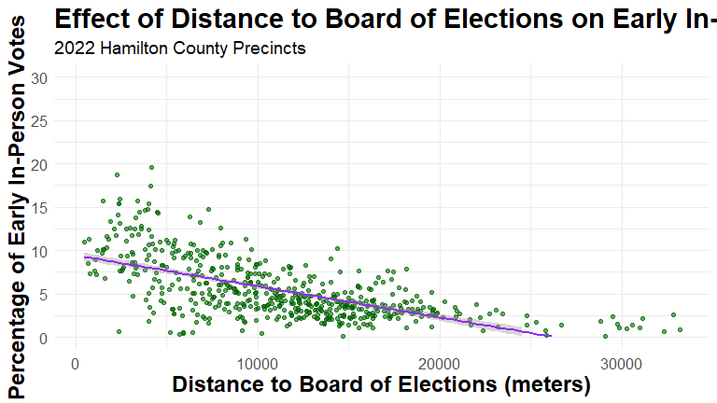
Here we can see how the Trend continues

Slide 15
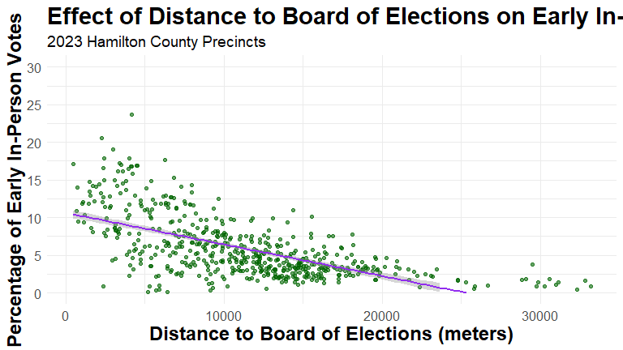
Here we can see how the Trend continues

Slide 16
Mail-in Voting Return Statistics
2024
79,523 requested, 70,097 returned -> (88.1% returned)
DEM 11,018 / 11,615 (94.9%)
REP 13,063 / 13,658 (95.6%)
Unaffiliated 46,016 / 54,250 (84.8%)
2020
155,883 requested, 148,026 returned -> (95.0% returned)
DEM 30,168 / 30,507 (98.9%)
REP 23,112/ 23,657 (97.7%)
Unaffiliated 94,746 /101,719 (93.1%)
Overall Mail-in Voting was higher in 2020

Slide 17
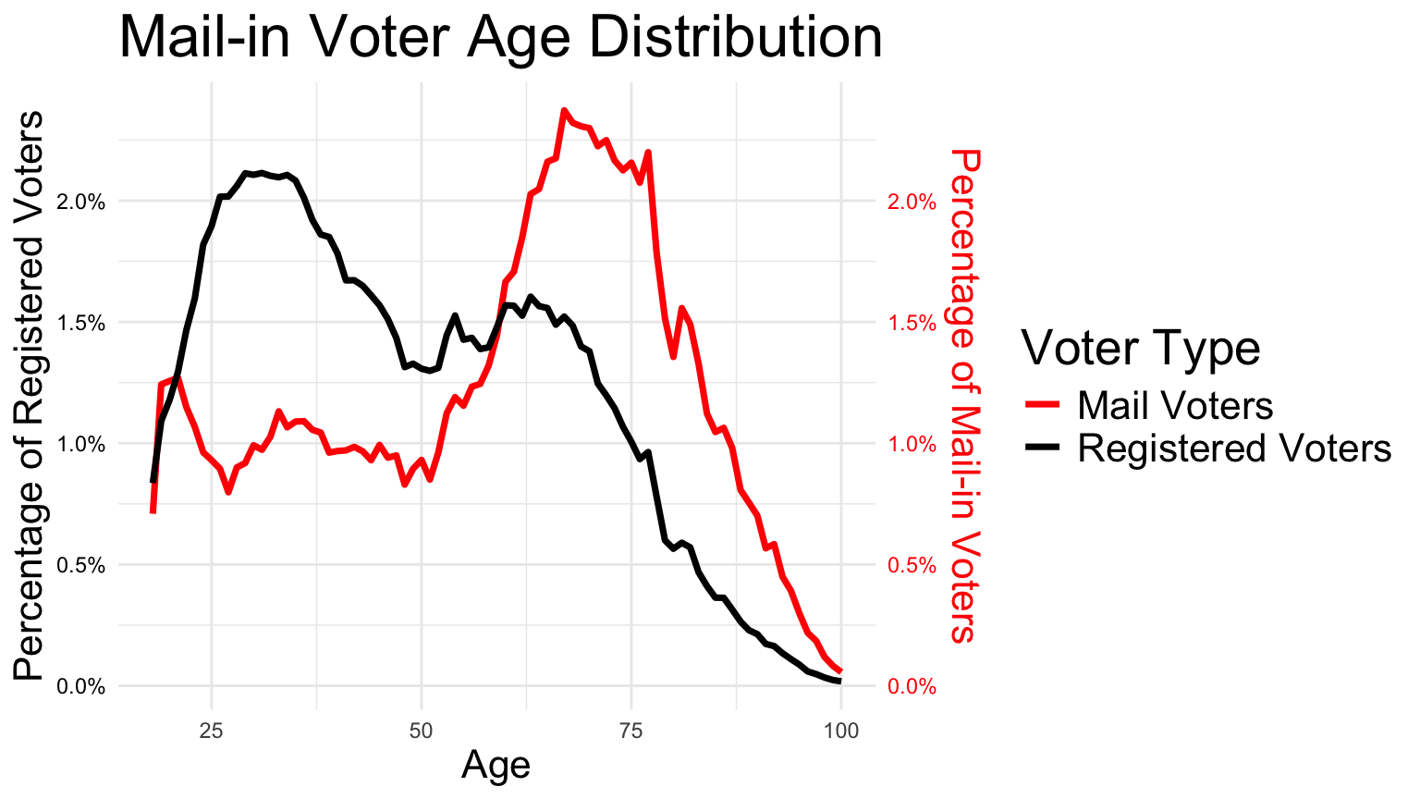
Age distribution of mail-in voting
Key Points:
Mail Voters (Red Line): The percentage of mail-in voters is notably higher among older age groups, peaking around ages 70-80. This indicates a strong preference for mail-in voting among senior voters. Early voting in 2024 consistently outpaces 2020, indicating increased early voter turnout or engagement.
Registered Voters (Black Line): The distribution of registered voters is more balanced across age groups, with a moderate peak around ages 25-30 and another smaller peak in the 60-70 age range.
Comparison: Younger age groups show a lower tendency to use mail-in voting compared to their representation among registered voters. In contrast, older voters, particularly those over 70, are more likely to choose mail-in voting over in-person options.

Slide 18
Overall partisan breakdown of "Early Votes" (in-person + mail-in)
In 2024: 165,918 TOTAL
DEM = 33,472 -> 19.1%
REP = 30,373 -> 17.3%
UN = 102,073 -> 58.2%
In 2020: 221,064 TOTAL
DEM = 45,771 -> 20.7%
REP = 34,273 -> 15.5%
UN = 141,020 -> 63.8%

Slide 19
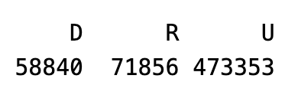

Age distributions of Registered Voters
Ohio’s Definition
Our Definition
Accepted wisdom says that younger voters are more likely to vote Democratic. We wanted to use the official list of registered voters to illustrate whether this is true and to what extent in Hamilton County
Includes:
Age distributions based on official party affiliation (by Ohio Law)
Age distributions based on our determination of party affiliation

Slide 20
Party Affiliation
By Ohio law a voter’s partisan affiliation is determined by voting in a political party’s primary election. A voter is a member of a political party if:
they voted in that party’s primary election within the preceding two calendar years, or
they did not vote in any other party’s primary election within the preceding two calendar years.
Our modified definition
A voter is affiliated with the party if they voted in that party’s primary election at any point in the past 3 presidential elections and have not voted in another party’s primary since the most recent primary where that voter has cast a ballot.

Slide 21
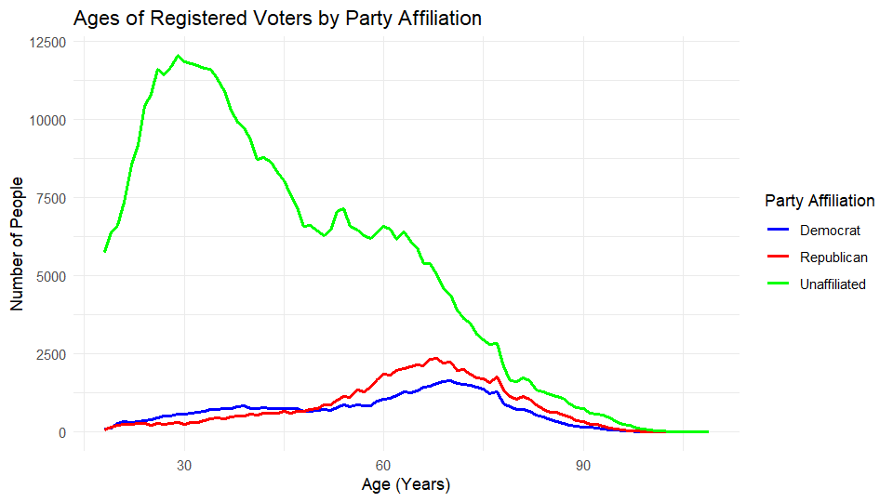
Average Ages:
Democrat: 58
Republican: 63
Unaffiliated: 45
Most registered voters in Hamilton County are not affiliated with a political party.

Slide 22
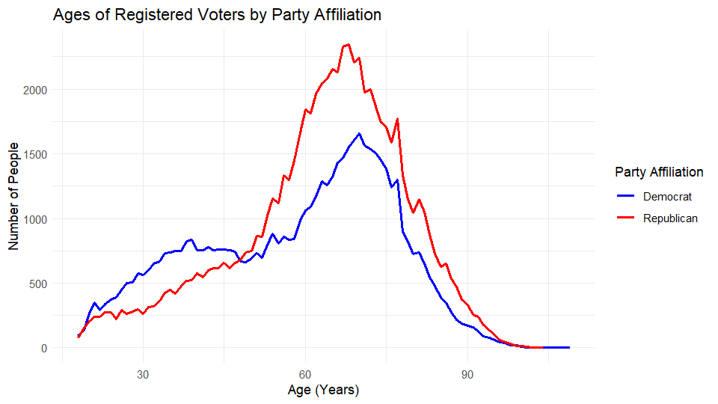
Average Ages:
Democrat: 58
Republican: 63
Younger voters are more likely to vote Democrat than Republican

Slide 23
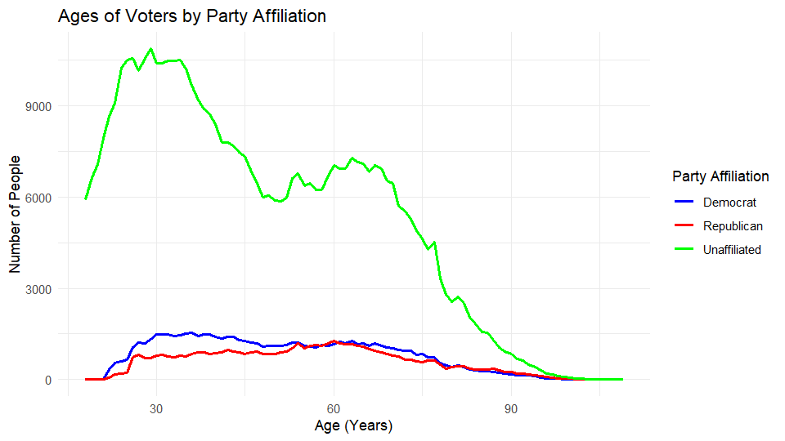
Average Ages:
Democrat: 51
Republican: 55
Unaffiliated: 47

Slide 24
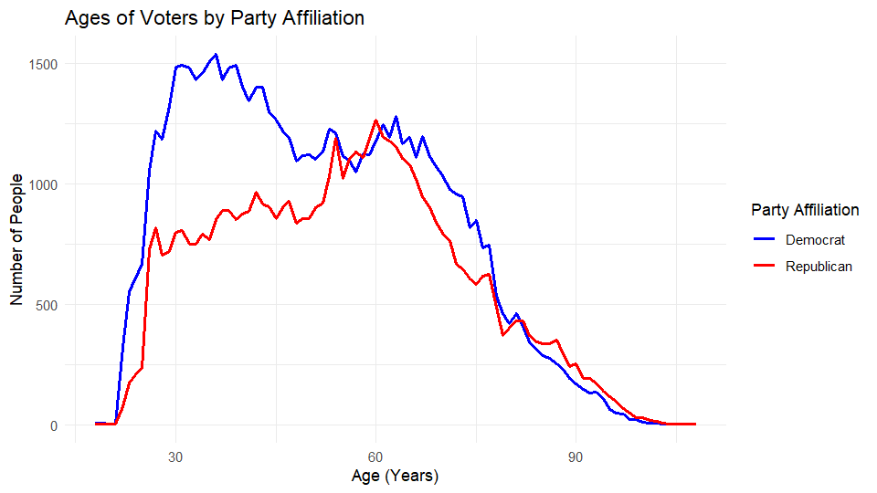
Average Ages:
Democrat: 51
Republican: 55

Slide 25
Key Takeaways
Limitation of legal definition of party affiliation
Leaves more voters officially unaffiliated
Younger voters more likely to be unaffiliated
Of those affiliated, more likely to be Democrats
Older voters more likely to be Republican

Slide 26
Dropoff for down ballot races
For previous prosecutor's race
For previous Court of Common Pleas field race

Slide 27
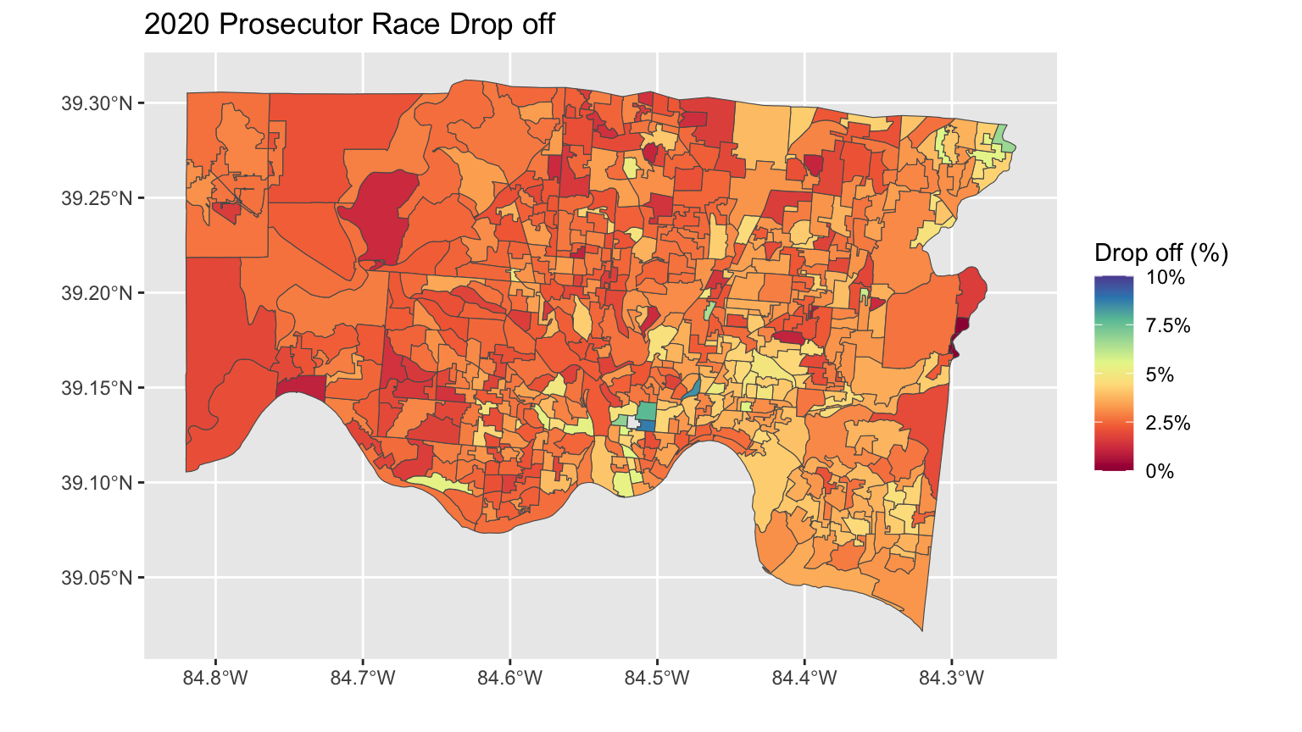

Slide 28
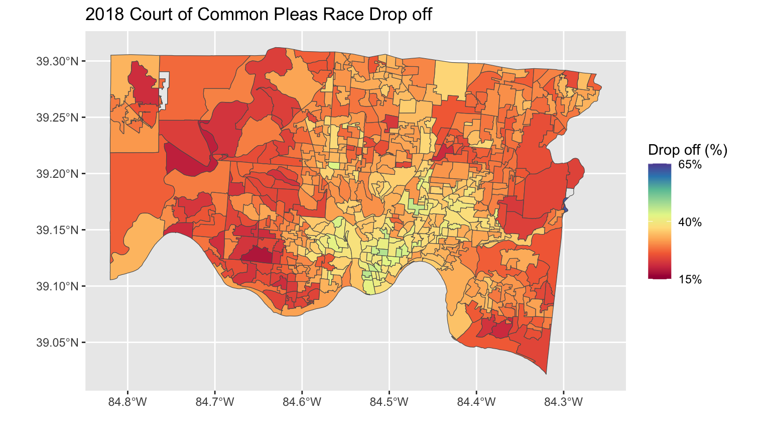

Slide 29
Estimating voter turnout for 2024
Key component of campaign strategy and magic number calculation.
Voter turnout is highly variable depending on the type of races that are in an election.

Slide 30
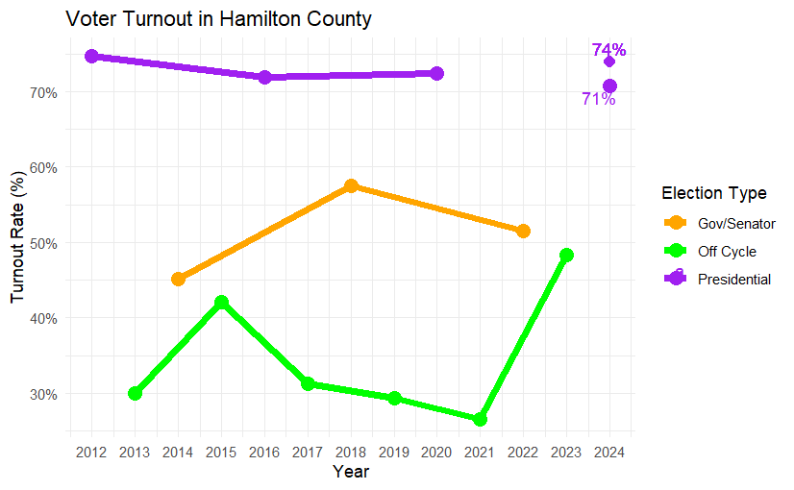
Range of turnout predictions
Reasons it could be higher
Key issues in the elections
Voting options are more accessible
Reasons it could be lower
Voters are not happy with any candidates, so they abstain from voting

Slide 31
Estimating the percentage of votes needed to win a field race
Head-to-head races are simple: a candidate needs to get 50% of the vote + 1 additional vote to guarantee a victory. In field races, this is more complicated.
Our goal was to estimate the percentage of votes necessary for a "Choose two out of five candidates" field race
Used computer simulation to run 1,000 such elections with randomness.
For each, we identified the percentage of votes needed to finish in the top two.
Evaluated the resulting distribution.

Slide 32
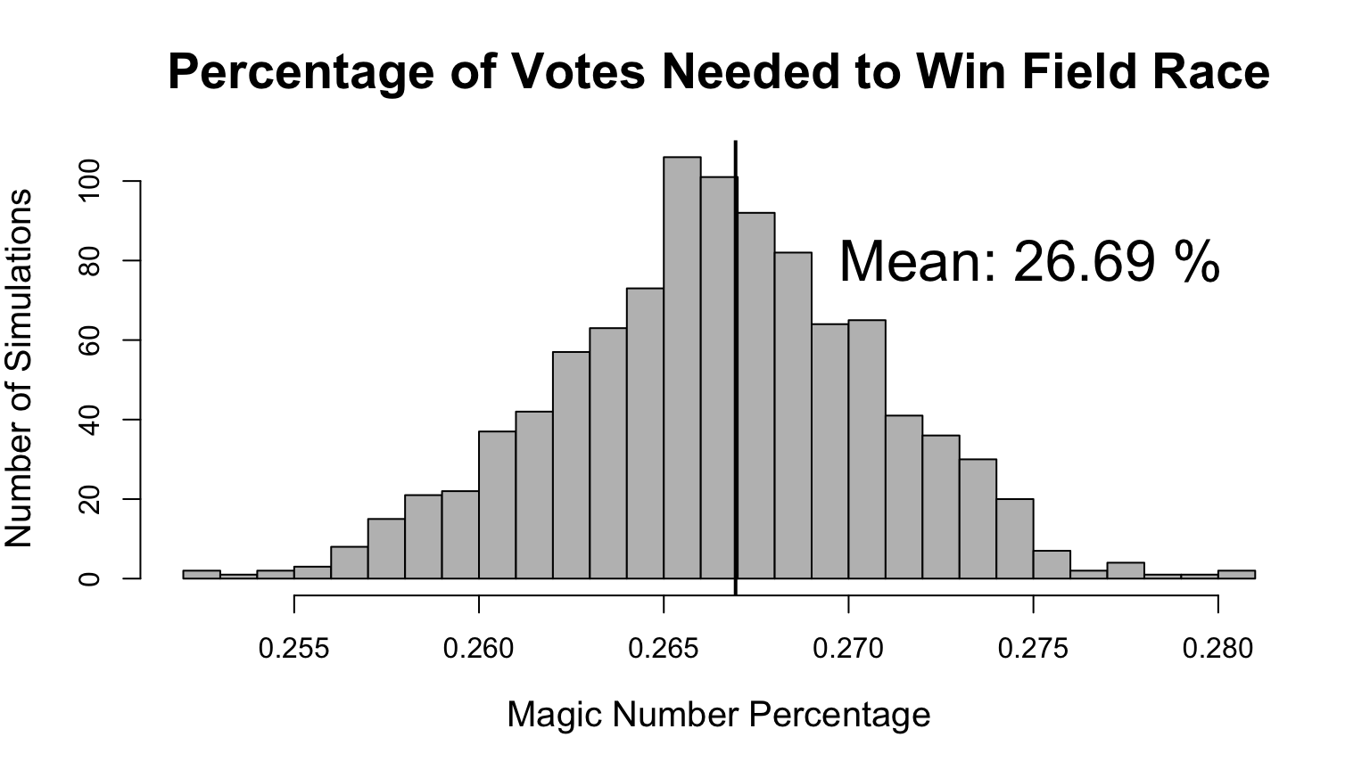

Slide 33
Comparison with previous results
2018 Court of Common Pleas Field Race
Four-person field race:
31.5%
29.7%
25.5%
13.2%
These results show that with an additional candidate, a magic number of 26.7% would make sense due to a greater distribution of votes

Slide 34
Fact sheet
We wanted a place to keep track of relevant numbers, statistics going into Election Night.

Slide 35
2016 General Election
In 2016 there were 580,354 total registered voters. Only 417,456 votes were cast.
Of those 417,456 voters 111,844 were absentee ballots.
215,719 votes for Clinton and Kaine, 63,150 of those votes coming from absentee ballots
173,665 votes for Trump and Pence. 41,531 of those votes came from absentee ballots
No data for issued absentee ballots for 2016 or 2020

Slide 36
2020 General Election
In 2020 there was 600,401 total registered voters. Only 434,956 votes were cast.
Of those 434,965 voters 250,866 were absentee ballots.

Slide 37
2024 Early Voting
Total of 114,079 absentee ballots requested
As of 10/22/24, 77,738 ballots have been returned
Democratic ballots issued: 18,223. Democratic ballots returned: 14,290
Republican ballots issued: 18,618. Republican ballots returned: 13,915
Party less ballots issued: 77,238. Party less ballots returned: 49,533
603,980 registered voters in Hamilton County
37,128 in office early votes have been placed since 10/8/24
11,762 of them were designated as Democratic, 8,617 of them Republican, and 16,749 did not carry any party tag

Slide 38
Comparisons
Already more registered voters in 2024 than both 2016 and 2020
To be exact: 100.596% more than 2020 and 104.071% more than 2016
There is no way to calculate percentages to compare the official results of absentee ballots because the 2024 election is not over yet
Based on registered voter's numbers being up we can expect the absentee total to be slightly higher than the last 2 elections

Slide 39
Political affiliation - Geography
As election results come in, people at the BOE will be looking at what precincts are reporting and speculating about what type of areas are left and how that could affect the results.
For these purposes, we make maps of the partisan leanings of the county
Official party affiliation by state law
Our adapted definition of party affiliation

Slide 40
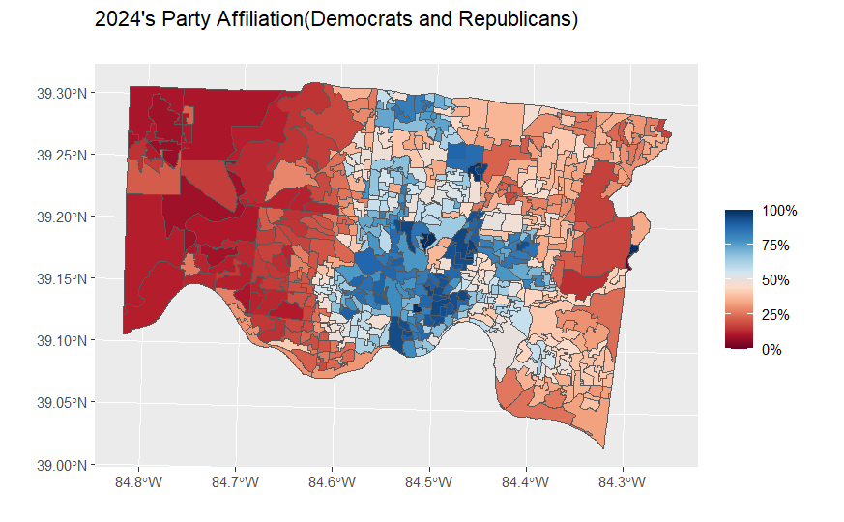
Top Democratic Areas
LINCOLN HEIGHTS VILLAGE:97.8%
CINTI WARD 18: 93.8%
CINTI WARD 7: 93.1%
CINTI WARD 17: 88.8%
CINTI WARD 13:88.4%
Top Republican Areas:
HARRISON TWP: 88.4%
CROSBY TWP: 87.9%:
MIAMI TWP: 87.7%
WHITEWATER TWP: 87.3%
THE VILLAGE OF INDIAN HILL CITY: 81.5%

Slide 41
Election results - Geography
Many races on the ballot this year have direct analogs in previous elections. These previous results are a driving force in campaign strategy and help us interpret incoming results on election night.
Previous results included
Brown vs. Renacci (2018) - Brown won Hamilton County
Trump vs. Biden (2020) - Biden won Hamilton County
Deters vs. Rucker (2020) - Deters won
Vance vs. Ryan (2022) - Ryan won Hamilton County
Issue #1 Reproductive Rights (2023)
Issue #2 Cannabis Legalization (2023)

Slide 42
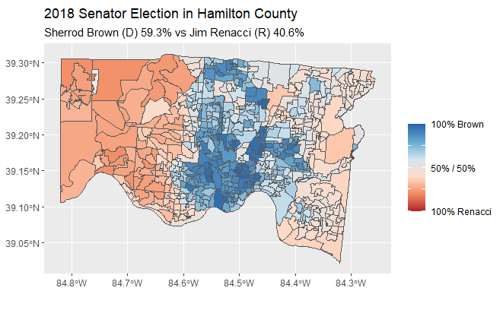

Slide 43
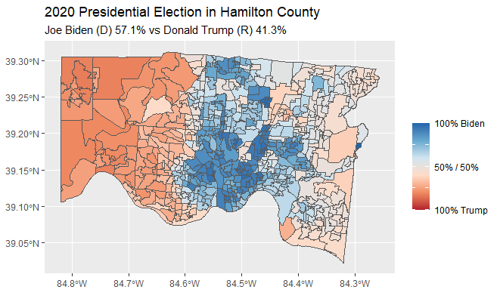

Slide 44
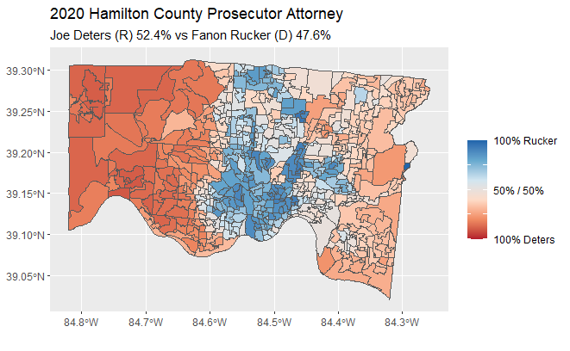

Slide 45
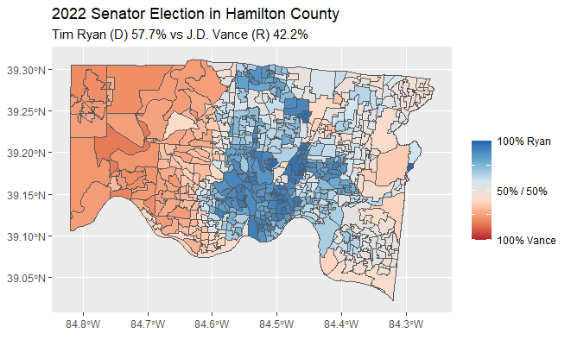

Slide 46
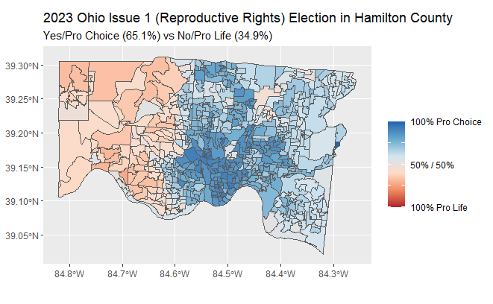

Slide 47
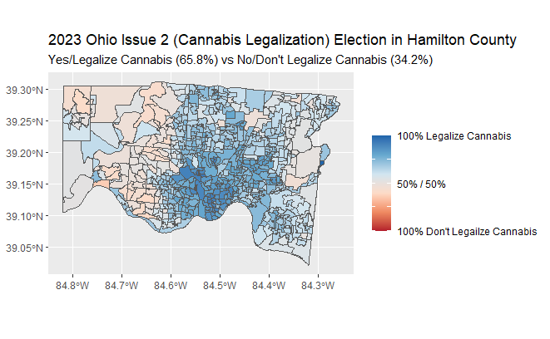

Slide 48
Split-ticket voting - Geography
Despite our current hyperpartisan climate, Democrats win certain highly contested races while Republicans win others. Consequently, there are voters who are willing to vote for either political party depending on the race/candidates.
To assess this, we look at the difference in support between Joe Deters (a Republican that won Hamilton County in 2020) and Donald Trump (a Republican that lost Hamilton County in 2020)
The largest differences indicate areas where voters are more open to split-ticket voting

Slide 49
